Slide 1

Web Applications – part 1
Trainers: Andrei Marica
Cristian Dumitru
Catalin Bina
Alexandru Krancevik
Tekin Omer-Ali
Authors: Viorel TACLICIU
Oana BESLIU

Slide 2

Contents
Tools
Web Development Introduction
JEE Containers
Apache Tomcat
Java Web applications - architecture
Request - Response model
HTTP
Servlets
Q&A

Slide 3
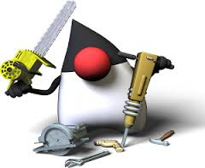
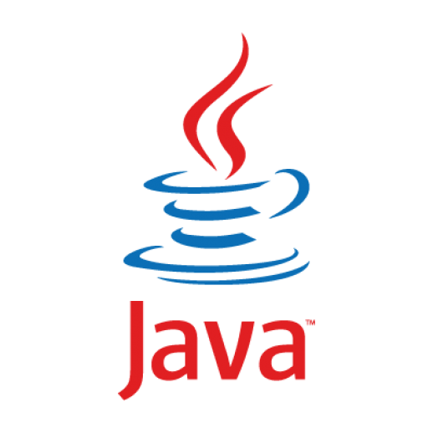




Tools
Java
Apache Maven
IntelliJ IDEA
Apache Tomcat
Docker
Notes:
Ingredient, o piesa a unui ansamblu.
In industria software :
Componenta este o parte complexa, aproape independenta, o parte inlocuibila a unui system si indeplineste o functie clara in contextul unei arhitecturi bine definite.

Slide 4
Web Development Introduction

Slide 5
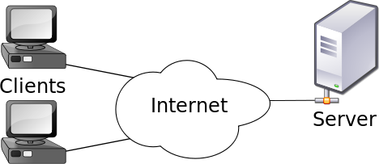
Web Development Introduction
Client-server model
Is a distributed application structure that partitions tasks or workloads between the providers of services and services requesters
Client – is the part that makes a request to a service
Server – is the part that actually provides services to it’s clients. A server could also act as a client and vice versa

Slide 6

Web Development Introduction
Repeated cycles - thick client to thin client, to thick…
Thick client (heavy, rich or fat client) is a computer (client) in a client – server architecture that typically provides rich functionality independent of the central server. A fat client still require a connection to a network or a server, but also has the ability to perform many functions without that connection
Thin client, in contrast, generally does little processing
From Swing Applications to JSP/Servlets Application to Angular JS Applications
Our technology stack is based on rich clients (Angular JS) and thin-servers that provide services to these clients
Notes:
Istoric: Cicluri intre thick (fat) client (Swing, Oracle Forms) – la thin (slim) client (JSP) - spre thick client (AngularJS, reactJS)
Until some 7 years ago we developed web application using thin clients
Now we develop web application based on browser-centric HTML5 applications talking to thin-servers
Our technology stack is based on rich clients (Angular JS) and the server provides services to these clients

Slide 7
JEE Containers & Web Container

Slide 8

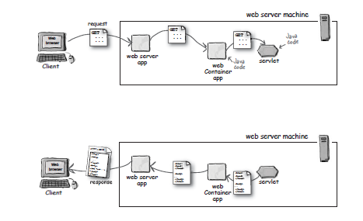
JEE Containers & Web Container
Are the interface between a Java component and the low-level platform-specific functionality
Provide separation of business logic from resource and lifecycle management
This allows developers to focus on writing business logic rather than writing enterprise infrastructure
The Java EE platform uses containers to simplify development
Notes:
Servlet doesn’t contain any main method. So who will initiate and run the method of Servlet? It’s Container who has the full control of Servlets. It is container which is responsible to manage the life-cycle of servlet. Web server hands the request to web container in which servlet is deployed and not to Servlet itself. Then container provides request and response to servlet. It is container which calls the servlet’s method.
Tomcat is the example of Servlet container.
When ever user request for any resource from Server Web server(Apache) will pass the request to Servlet Container(Tomcat) instead of directly to servlet. It is container who will create request and response Object and then pass it to Servlet eligible for asked resource and invoke service method of Servlet.
Note: HttpServletRequest and HttpServletResponse are interfaces. It is container which implements given interface

Slide 9
Web Container
The web container is the interface between web components and the web server.
The web container offers:
Communication Support
Lifecycle Management
Multi-threading support
Security
JSP Support
A web component can be a Servlet, a JSP page, or a Java Server Faces page.
Notes:
Web container (also known as a Servlet container or webtainer) is the component of a web server that interacts with Java servlets. A web container is responsible for managing the lifecycle of servlets, mapping a URL to a particular servlet and ensuring that the URL requester has the correct access rights.
A web container handles requests for servlets, Java Server Pages (JSP) files, and other types of files that include server-side code. The Web container creates servlet instances, loads and unloads servlets, creates and manages request and response objects, and performs other servlet management tasks.
A web container implements the web component contract of the Java EE architecture, specifying a runtime environment for web components that includes security, concurrency, lifecycle management, transaction, deployment, and other services.

Slide 10
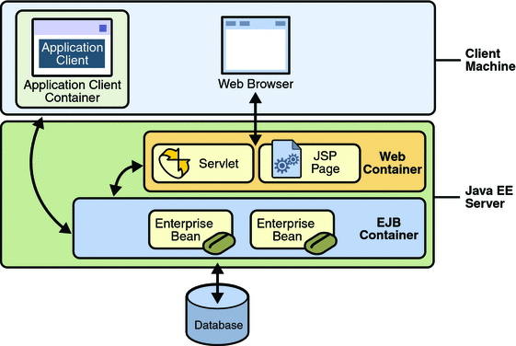
JEE Containers

Slide 11
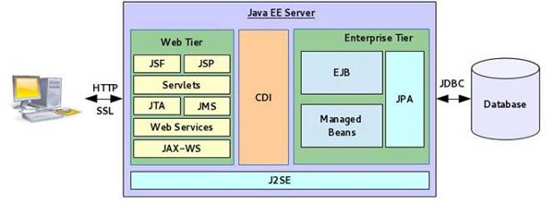
JEE Containers

Slide 12
Apache Tomcat

Slide 13
Apache Tomcat
Apache Tomcat is an open source web server and servlet container
Tomcat implements the Java Servlet and the JavaServer Pages (JSP) specifications from Oracle, and provides a "pure Java" HTTP web server environment for Java code to run in.
In the simplest configuration Tomcat runs in a single operating system process. The process runs a Java virtual machine (JVM). Every single HTTP request from a browser to Tomcat is processed in the Tomcat process in a separate thread.
Apache Tomcat includes tools for configuration and management, but can also be configured by editing XML configuration files.
Notes:
Apache Tomcat (or simply Tomcat, formerly also Jakarta Tomcat) is an open source web server and servlet container developed by the Apache Software Foundation(ASF).
Tomcat implements the Java Servlet and the JavaServer Pages (JSP) specifications from Oracle, and provides a "pure Java" HTTP web server environment for Java code to run in. In the simplest configuration Tomcat runs in a single operating system process.
The process runs a Java virtual machine (JVM). Every single HTTP request from a browser to Tomcat is processed in the Tomcat process in a separate thread.
Apache Tomcat includes tools for configuration and management, but can also be configured by editing XML configuration files.

Slide 14
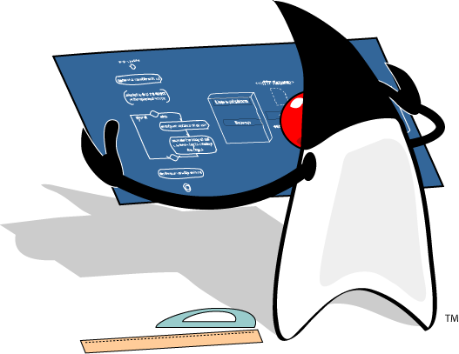
Apache Tomcat - workshop
Open file Workshop 1 - Server configuration.docx
Begin workshop

Slide 15
Web applications - architecture

Slide 16

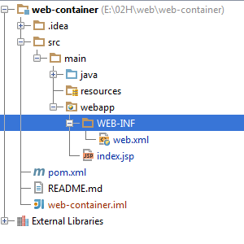
Web applications - architecture
Maven standardizes the sources structure of a web application
src/main/java –JAVA classes
src/main/resources – configuration resources
src/main/web-app –web resources – jsp pages, static pages
src/main/web-app/WEB-INF – configuration files for web applications

Slide 17
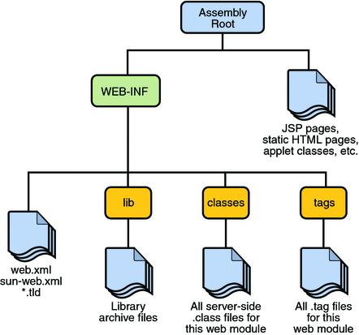
Web applications - architecture
.war archive architecture
Notes:
The web applications that are deployed in our container are archives with the “.war” extension
It is mandatory that the web archive contains the folder /WEB-INF in the structure
Under WEB-INF folder we’ll have another folder named /lib where we’ll find all the “.jar” dependencies of our web application
Under WEB-INF folder we’ll have another folder named /classes where we’ll find all the compiled classes of our application
Under WEB-INF folder we’ll find a file named web.xml, if we use the 2.x version of the Servlet API
They are portable because they are written in JAVA

Slide 18
Web applications - workshop
Open file Workshop 2 - Web application.docx
Begin workshop

Slide 19
Request - Response model

Slide 20
Request - Response model
Request–response or Request–reply is one of the basic methods computers use to communicate to each other.
When using request–response, the first computer sends a request for some data and the second computer responds to the request.
Browsing a web page is an example of request–response communication.
One can think of request–response as being like a telephone call, where you call someone and they answer the call.

Slide 21


Request - Response model
The client’s request contains the name and address (the URL), of the thing the client is looking for.
HTTP
Request
Server
request
<html>
<head>
<body>
…
<html>
<head>
<body>
…
response
Client
HTTP
HTML
The server’s response contains the actual document that the client requested (or an error code if the request could not be processed).
Notes:
Web browser
may be the client and an application running on a computer hosting a web site may be the server. The client submits an HTTP request message to the server. The server, which provides resources such as HTML files and other content, or performs other functions on behalf of the client, returns a response message to the client. The response contains completion status information about the request and may also contain requested content in its message body.

Slide 22
Request - Response model
HTTP Response key elements :
Status code
Context-type
The content
HTTP Request key elements:
HTTP method
The page to access - URL
Form parameters

Slide 23
HTTP

Slide 24
HTTP
HTTP – Hypertext Transfer Protocol
is an application protocol for distributed, collaborative, information systems
is the foundation of data communications for www
functions as a request - response protocol in the client - server computing model
URL – Uniform Resource Locator
is a specific character string that constitutes a reference to a resource
Form Parameters
represent values that are sent with the request

Slide 25
HTTP
Status code - (HTTP) response status codes
specifies one of five classes of response:
1xx – Informational
2xx – Success
3xx – Redirection
4xx – Client Error
5xx – Server Error
Context-type header
describes the data contained in the body fully enough that the receiving user agent can pick an appropriate agent or mechanism to present the data to the user
The content
is the data received by the client from the server

Slide 26
HTTP - Methods
The most commonly used are :
GET - Request to retrieve a resource such as an HTML file or an image file.
POST - Request for the server to accept the data being sent from the client to insert new server data.
PUT - Request for the server to accept the data being sent from the client to modify existing server data.
DELETE - Request for the server to delete a specific resource.
Notes:
The most commonly used are : GET, POST, PUT and DELETE
GET - Requests a representation of the specified resource.
Requests using GET should only retrieve data and should have no other effect.
Using GET client data is transmitted to server in URL as query strings(name/value pairs)
Query String is the part from URL that proceed “?” character
A GET Example /test/demo_form.jsp?name1=value1&name2=value2
POST – Submits data to be processed to a specified resource
Using POST data is transmitted to server in request body
POST /test/demo_form.jsp HTTP/1.1 Host: w3schools.com name1=value1&name2=value2

Slide 27
HTTP - GET v/s POST
GET
The client data is transmitted to server in URL as query strings(name/value pairs)
QueryString is the part from URL that proceed “?” character
GET example : URL -> …/test/demo_form.jsp?name1=value1&name2=value2
POST
Submits data to be processed to a specified resource
Using POST data is transmitted to server in request body
POST example : URL -> …/test/demo_form.jsp HTTP/1.1
Body -> name1=value1&name2=value2

Slide 28
HTTP - GET v/s POST
 | GET | POST
HTTP Request | The request contains only the request line and HTTP header. | Along with request line and header it also contains HTTP body.
Parameter passing | The form elements are passed to the server by appending at the end of the URL. | The form elements are passed in the body of the HTTP request.
Size | The parameter data is limited (the limit depends on the container) | Can send huge amount of data to the server.
Idempotency | GET is Idempotent | POST is not idempotent
Usage | Generally used to fetch some information from the host. | Generally used to process the sent data.

Slide 29
Servlets

Slide 30
Servlets
The servlet is a Java programming language class used to extend the capabilities of a server.
Servlets can respond to any types of requests, they are commonly used to extend the applications hosted by web servers
A servlet is an object that receives request and generates response based on that request
The servlet is an interface under the javax.servlet package from servlet API
A common used implementation is javax.servlet.http.HttpServlet
You could extends this class to implement your own servlet
Notes:
Servlets are shy little creatures. They sit on the hard drive just minding their own business, and don’t bother anyone until they've been invoked. However, feed a few drinks to those Servlets – get them loaded – and they remain resident in memory until the party ends, which happens when someone pulls the plug on the application server.
If the Servlet hasn’t been called before, the JVM loads the Servlet and then generates a thread to handle the request.

Slide 31
Servlets - lifecycle
The Servlet lifecycle is simple, there is only one main state – “Initialized”.
Does not exist
constructor()
destroy()
init()
Initialized
Service()

Slide 32
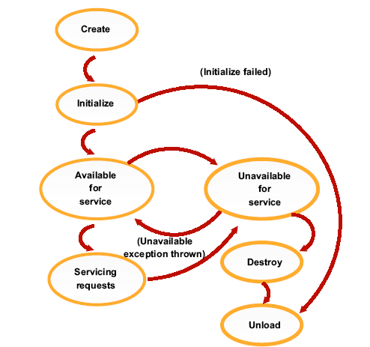
Servlets - lifecycle
The server will automatically call:
public void init():
Called only once when servlet is being
created.
Good place for set up, open Database,
etc.
public void service():
Called once for each request.
In HttpServlet, it delegates
requests to doGet, doPost, etc.
public void destroy():
Called when server decides to
terminate the servlet.
Release resources.

Slide 33
JEE Containers & Web Container
How does the HTTP Servlet handle a request?
request
GET.
…..
Servlet
Web
Container
request
Thread Pool
Http request
response
Thread
Client
Web
Server
response
response
<Html>
<Body>
…….
</Body>
</Html>
Service()
HTTP
HTML
doGet()
Notes:
From Web Server to Application Server
When a client makes a request for a JSP or a Servlet, the request initially goes to the Web server. The Web server reads the special XML file the application server provides, and realizes that the request that came in should be sent to the application server for processing.
The special XML file also provides the IP address/port combination of listening application servers. The Web server, using the http protocol, then sends the request to the Application server JVM listening on the appropriate port.
The JVM listening on the appropriate port represents our application server, and the port the JVM listens on can be configured through that JVM’s Web container.
The Web server handles the incoming request, and matches that request to the application server set up to handle the given Servlet or JSP.
Inside the Web Container
If the Servlet hasn’t been called before, the JVM loads the Servlet and then generates a thread to handle the request.
So, the request gets sent from the client, to the Web server, and the Web server passes the request to the application server, who in turn invokes and threads the appropriate Servlet.

Slide 34
Servlets - lifecycle
 | When is it called | What it’s for | Do you override it
init() | The container calls the init() before the servlet can service any client requests. | To initialize your servlet before handling any client requests. | Possibly
service() | When a new request for that servlet comes in. | To determine which HTTP method should be called. | No. Very unlikely
doGet() or doPost() | The service() method invokes it based on the HTTP method from the request. | To handle the business logic. | Always
Notes:
What does our Servlet do?
Well, the Servlet can do pretty much anything the developer wants it to do. When programming Servlets, a developer is only limited by their creativity, and more likely, their Java programming skills.
Typically, a Servlet implements some control logic. For example, a Servlet might figure out what a user typed into some text fields in a web-based form. It might then take that information and save it to a database.
Servlets are intended to be controllers. While Servlets can interact directly with a database, they’re not really supposed to. Instead, Servlets are supposed to delegate to a JavaBean or an EJB to do such things.

Slide 35
Servlets – Deployment Descriptor
Web.xml
Is the deployment descriptor file for web applications and is part of the servlet standard for web applications
determines how URLs map to servlets, which URLs require authentication, and other information
The file is an XML file whose root element is <web-app>
<servlet>
<servlet-name>myServlet</servlet-name>
<servlet-class>class name</servlet-class>
</servlet>
<servlet-mapping>
<servlet-name>myServlet</servlet-name>
<url-pattern>/myServlet</url-pattern>
</servlet-mapping>
Notes:
The web applications that are deployed in our container are archives with the “.war” extension
It is mandatory that the web archive contains the folder /WEB-INF in the structure
Under WEB-INF folder we’ll have another folder named /lib where we’ll find all the “.jar” dependencies of our web application
Under WEB-INF folder we’ll have another folder named /classes where we’ll find all the compiled classes of our application
Under WEB-INF folder we’ll find a file named web.xml, if we use the 2.x version of the Servlet API
They are portable because they are written in JAVA

Slide 36
Servlets - custom http servlet
Interface
javax.servlet.Servlet
Abstract class
javax.servlet.GenericServlet
If not overridden, implements init()
method from the ‘Servlet’ interface,
Abstract class
javax.servlet.http.HttpServlet
If not overridden, implements service()
method.
Concrete class
Your Servlet
We implement the HTTP methods
here.
Notes:
public interface Servlet {…}
public abstract class HttpServlet extends GenericServlet
implements java.io.Serializable{…}
To create your own servlet you must extend HttpServlet and override doGet or doPost method

Slide 37
Servlets - custom http servlet
In web.xml you have to declare the servlet and map it to a url or multiple urls :
<servlet>
<servlet-name>HelloWorld</servlet-name>
<servlet-class>ro.teamnet.z2h.web.HelloWorldServlet</servlet-class>
</servlet>
<servlet-mapping>
<servlet-name>HelloWorld</servlet-name>
<url-pattern>/hello</url-pattern>
</servlet-mapping>

Slide 38
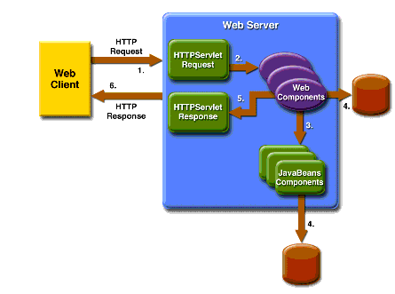
Servlets - custom servlet
The method that you’ve overridden takes two parameters:
an HttpServletRequest object – represent request from client
an HttpServletResponse object – represent response to client

Slide 39
Servlets - HttpServletRequest
Represents the client request
The mostly used methods are :
getHeaders() returns all the values of the specified request
getHeaderNames() returns an enumeration of all the header names
getMethod() returns the http method
getQueryString() returns query string
getCookies() returns cookies from the client
getParameterNames() returns an enumeration containing all parameters names from the client
getParameter() takes an argument representing the parameter name and returns the parameter value

Slide 40
Servlets - HttpServletResponse
Represents the server response
The mostly used methods are:
getWriter() returns a PrintWriter object that can send character text to the client.
setContentType() sets the content type of the response . If you return an html then invoke the method with “text/html” as argument value
addHeader() adds a response header with the given name and value

Slide 41
Servlets - workshop
Open file Workshop 3 - Servlets.docx
Begin workshop

